Slide 1


Data-Driven Recruitment System
Optimizing Biased Talent Acquisition Through Data-Driven HR Analytics

Slide 2



Men Behind The Gun
Fadli Nurrizky
PM & Engineering
Irfan Aulia Rahman
Analyst & Scientist
Shan Ramadhan
Analyst & Scientist

Slide 3
Business Understanding

Slide 4



Business & Industry Research
The Strategic Context
Market Trends
(2024–2026)
The Paradigm Shift
Market Projections
HR management is evolving from qualitative "gut-feelings" to objective, logical People Analytics.
Global spending projections for AI & analytics in HR by 2025 with a compound annual growth rate of 24.5%.
Talent as a Competitive Asset
68% Adoption
Data-driven organizations are 19x more likely to be profitable than non-data-driven peers.
Companies today are already using data-driven recruitment strategies for efficiency.
Scale of Engagement
44% Reskilling
Manual screening is not possible on large applicant volumes
(e.g. Google ~2M applications) without sacrificing quality.
Focus shifts from past positions to validated skill sets. The World Economic Forum 2025 of workers will require reskilling by 2030.

Slide 5

Problem & Goal Statements
The Risks of Conventional Hiring
Goals & Objectives
The Cost of Failure
Goals
Harvard Business Review reports that 80% of employee turnover is caused by poor hiring decisions.
Transform the conventional recruitment process into a data-driven system to improve talent selection accuracy and company operational cost efficiency.
Financial Leakage
A single "bad hire" can cost an organization between 50% and 200% of the employee's annual salary when factoring in recruitment, onboarding, and lost productivity. Assuming the annual salary of a tech employee is ~IDR 63.36 million, an organization might lose 31.68 to 126.72 million rupiah.
Objectives
Build an objective, automated model by analyzing qualification variable correlations, determining success score thresholds, and conducting bias audits to ensure fairness in recruitment decision-making.
Subjectivity Bias
HR team struggles to make consistent and fair hiring decisions due to reliance on subjective judgment. This leads to inefficiency, bias, and missed opportunities.

Slide 6
Success Metrics & Business Impact
The KPIs for Data-Driven Era
The Value Proposition
F1-Score
The main benchmark for balancing Precision and Recall.
1. Operational Cost Efficiency
Organizations adopting data-driven strategies report a 20-30% reduction in hiring costs by decreasing reliance on third-party agencies and manual labor.
Quality of Hire (QoH)
Measured by the 15% average improvement in how well new employees fit their roles and contribute to company goals.
2. Reduced Attrition
Predictive models can identify high-risk departures with 90% accuracy, allowing for proactive interventions that protect your recruitment ROI.
Hiring Efficiency
Reduce manual screening by up to 80%.
Selection Accuracy
Machine learning models (e.g., Random Forest, XGBoost) can achieve accuracy rates exceeding 95% in predicting candidate suitability based on historical high-performer data.
3. Diversity & Inclusion
Data-driven systems can reduce unconscious bias by anonymizing candidate profiles (removing name, gender, age) and focusing strictly on objective qualifications.

Slide 7
Project Timeline & Workflow (CRISP-DM)
07-03-2026
14-03-2026
04-04-2026
11-04-2026
18-04-2026
02-03-2026
09-03-2026
30-03-2026
06-04-2026
13-04-2026
Stage 0
Business Understanding
Stage 1
Data Understanding
Stage 2
Modeling
Stage 3
Model Evaluation
Stage 4
Deployment
Data Preparation
Problem Statement, Goals & Objectives
Exploratory Data Analysis
Preprocessing & Feature Enginering
Model Training & Prediction
Performance Assessment & Validation
Integration & Release

Slide 8
Pipeline Model
Data Cleaning
Missing Value, Duplicate Data, Outlier
Model Evaluation
Data Input
Model Deployment
Data Prepocessing
Feature Selection,
Encoding, Scaling
Prediction Output
Monitoring
Model Training

Slide 9
Risk-Feasibility
Aspect | Potential Risk | Mitigation Strategy | Feasibility
Data | Historical bias in the 1,500 candidate records due to previous subjective manual hiring decisions. | Conduct regular Fairness & Bias Audits. | Data is available for auditing to ensure objective outcomes.
Technical | Model fails to balance selection precision with the ability to capture potential talent. | Use F1-Score to balance Precision and Recall to reduce bias in modeling, hence minimize bad candidate and maximize good candidate acceptance. | F1-Score provides a robust technical validation framework.
Operational | HR teams find it difficult to adopt new systems. | System integration that provides instant predictions. | Data-driven systems minimize intuition-based risks.
Economic | Marketing budget wasted on recruitment channels with low conversion rates. | Perform data-driven evaluations of Recruitment Strategy ROI to optimize budget allocation. | ROI analysis ensures targeted and cost-effective spending.
Strategic | Inaccurate threshold settings for candidate scores, leading to high-risk hires. | Execute Sensitivity Analysis to identify critical score thresholds that guarantee >80% hiring success. | Ensures only top-quality talent is onboarded to boost productivity.

Slide 10
Exploratory Data Analysis

Slide 11



Descriptive Statistics
Features | Description
Age | Candidate’s age
ExperienceYears | Candidate’s total years of work experience
PreviousCompanies | Candidate’s total previous company
DistanceFromCompany | Candidate’s home distance from company
InterviewScore | Candidate’s interview score result
SkillScore | Candidate’s technical score result
PersonalityScore | Candidate’s personality score result
Gender | 0 = Male, 1 = Female
EducationLevel | 1 = High Shcool, 2 = Diploma/Bachelor, 3 = Magister, 4 = PhD
RecruitmentStrategy | 1 = Internal, 2 = External, 3 = Referral
HiringDecision | Target: 0 = Not Hired, 1 = Hired
ExperienceLevel | Junior (0-2 YoE), Medior (2-5 YoE), Senior (5+ YoE)
Data shape: 1.500 rows and 11 feature columns
Feature type: 7 numerical, 3 categorical, 1 target
Missing values: 0
Duplicate values: 0
Outliers: 0
Numerical Features
Categorical Features
Age
ExperienceYears
PreviousCompanies
DistanceFromCompany
InterviewScore
SkillScore
PersonalityScore
Gender
EducationLevel
RecruitmentStrategy
Target: Hiring Decision
Feature Engineering
Hired
ExperienceLevel
31%
Transforms continuous numerical data in ExperienceYears feature into discrete categories (binning).
Not Hired
69%

Slide 12
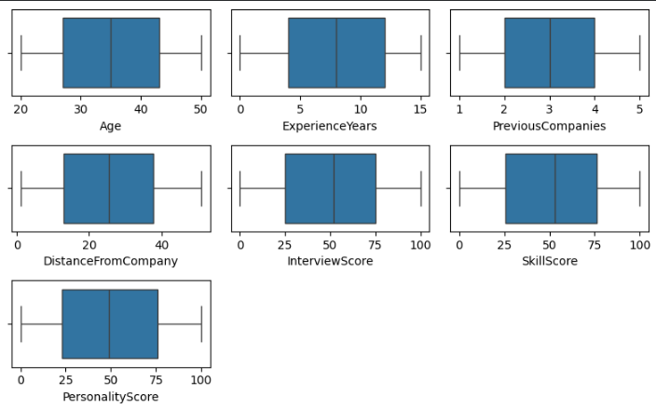
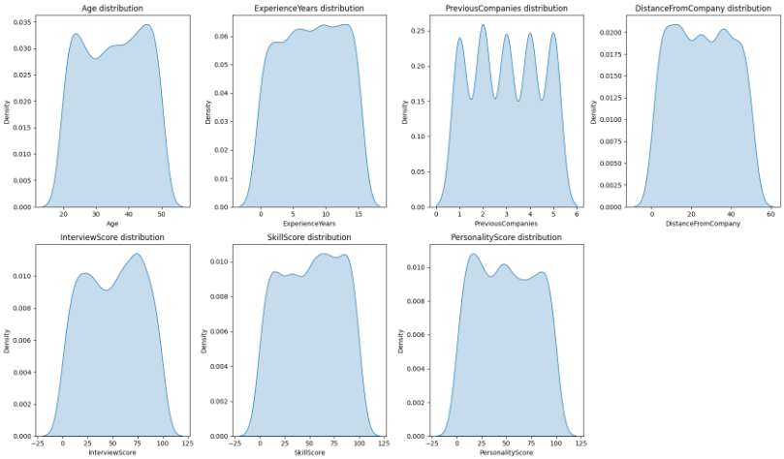
Univariate Analysis
No data points were found outside the whiskers for each features. This indicates the dataset is free from outliers, thus model will not be affected by significantly deviant values.
The distribution plot looks approximately symmetric, meaning no significant skew is present.
Due to the neat data distribution and lack of outliers, this dataset is ideal and can move into the modeling stage without the need for complex outlier handling.

Slide 13
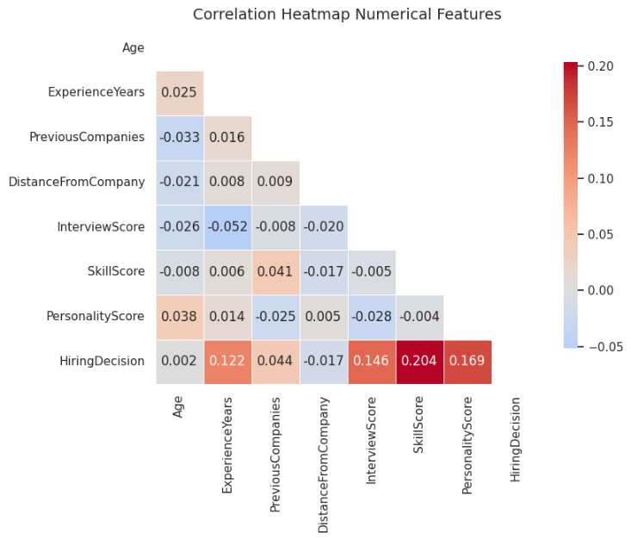
Multivariate Analysis
Most of the numerical features have a low to moderate correlation with each other, with correlation values ranging from -0.052 hingga 0.044.
No features show a very high correlation (above 0.8), which indicates that there is no significant multicollinearity among them.
Features such as ExperienceYears, InterviewScore, SkillScore, PersonalityScore, show a significant positive correlation with the target label (HiringDecision)."

Slide 14
Chi-Square & ANOVA Test Result
ANOVA
Chi-Square
Feature | F-stat | p-value
Age | 0.005 | 0.9429
ExperienceYears | 22.819 | 0.0000
PreviousCompanies | 2.909 | 0.0883
DistanceFromCompany | 0.422 | 0.5158
InterviewScore | 32.656 | 0.0000
SkillScore | 64.827 | 0.0000
PersonalityScore | 44.137 | 0.0000
Age | 0.005 | 0.9429
Chi2 | p-value | dof | Feature
0.001 | 0.9751 | 1 | Gender
103.675 | 0.0000 | 3 | EducationLevel
489.681 | 0.0000 | 2 | RecruitmentStrategy
39.198 | 0.0000 | 2 | ExperienceLevel

Slide 15
Insight Extraction

Slide 16
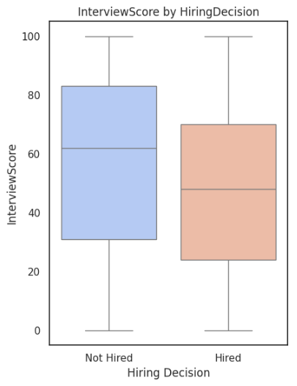
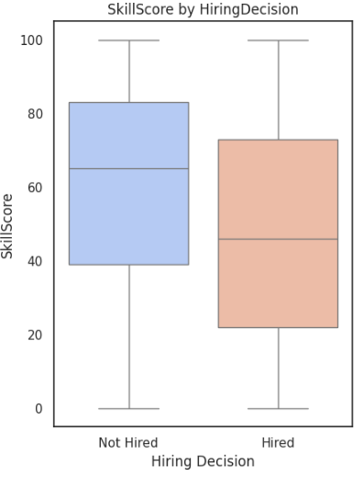
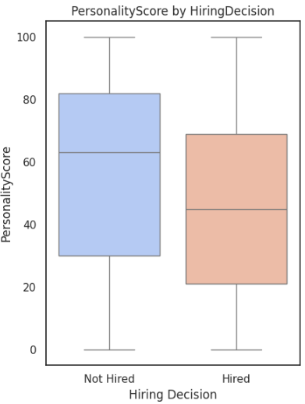
Score-based Features Likely Insignificant to Hiring Decision
InterviewScore: Unsuccessful candidates had a median interview score above 60. Accepted candidates had a median below 50. This indicates that in this dataset, interview scores were not a primary determinant of recruitment success, or that other factors were more dominant.
SkillScore: The range of skill scores for successful candidates was wider, with a median of around 45. Meanwhile, unsuccessful candidates had a higher concentration of scores in the upper range (median >60).
PersonalityScore: Shows a similar pattern to the other variables, with the lower bound (Q1) for successful candidates being (~20) and the lower bound (Q1) for unsuccessful candidates being (~30).

Slide 17
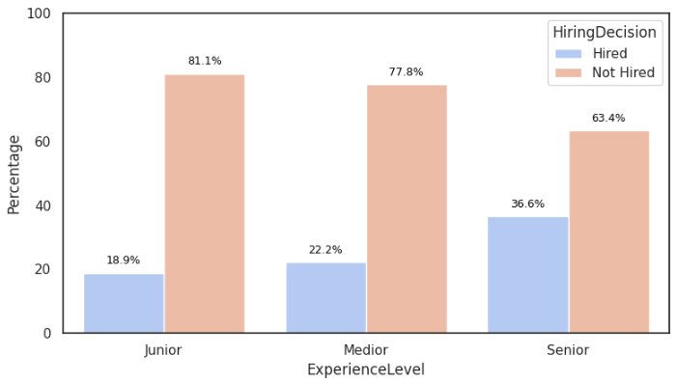
Senior-level Candidates are More Likely to be Hired
ExperienceLevel is significant to HiringDecision
From the data shown, we can visualize a direct positive correlation between experience level and hiring success. Senior-level candidates are significantly more likely to be hired compared to Junior and Medior levels, suggesting a strong industry preference for established expertise.
Senior candidates have the highest hiring rate at 36.6%, which is nearly double that of Junior candidates (18.9%) whereas Junior applicants face the toughest competition, with a non-hiring rate of 81.1%.
Incremental Growth: There is a steady upward trend in "Hired" percentages as candidates move from Junior (18.9%) to Medior (22.2%) and finally Senior (36.6%).

Slide 18
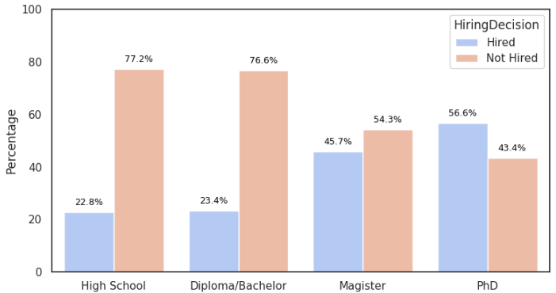
Higher Education Level = Higher Probability to be Hired
EducationLevel is significant to HiringDecision
Candidates with a high school (22.8%) and a diploma/bachelor (23.4%) have almost equally low acceptance rates. The vast majority (over 76%) of this group failed the selection process.
Magister’s degree graduates shows a significant increase in their chances of being accepted, reaching (45.7%). This suggests that a magister’s degree is an important "threshold" for companies in selecting candidates.
PhD degree graduates have the highest hiring rate at (56.6%). This was the only group where more candidates were accepted than rejected (above 50% ratio).

Slide 19
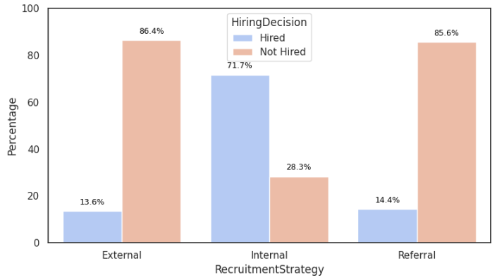
Most Hired Candidates are Internal Applicants
RecruitmentStrategy is significant to HiringDecision
The internal recruitment strategy has a success rate far exceeding other channels. 71.7% of candidates through the internal channel are hired. This is the only category where the number of accepted candidates significantly outnumbers those rejected.
In contrast to internal applicants, candidates who come from outside sources or through referrals have a very low chance of being accepted:
External: Only 13.6% are accepted.
Referral: Only 14.4% are accepted.
Both of the non-internal applicants have high rejection rates, exceeding 85%.

Slide 20

Feature Selection
The features identified as strongly correlated with the target should be prioritized for modeling, as they are expected to yield the best evaluation results.
ExperienceYears
ExperienceYears shows a moderate correlation with hiring outcomes and contains many unique values, making it suitable for binning.
SkillScore
Skill Score shows a moderate correlation with hiring outcomes, where candidates with higher scores are more likely to be accepted.
DistanceFromCompany
DistanceFromCompany did not show a statistically significant effect on recruitment decisions.
EducationLevel
Candidate education level shows a fairly strong correlation with hiring outcomes, with higher educational levels associated with greater acceptance.
InterviewScore
Interview Score shows a moderate correlation with hiring outcomes, where candidates with higher scores are more likely to be accepted.
ExperienceLevel
There is a significant relationship where higher levels of experience tend to have a greater chance of acceptance.
RecruitmentStrategy
Recruitment strategy shows a strong correlation with hiring outcomes, with aggressive strategies leading to higher acceptance rates.
PersonalityScore
Personality Score shows a moderate correlation with hiring outcomes, with higher scores linked to a greater likelihood of acceptance.
Age
Age had no significant correlation with recruitment outcomes, indicating that the model provides equal opportunities regardless of candidate age.
PreviousCompanies
This feature shows an insignificant effect. This means that the number of companies a candidate has previously worked for is not a major determinant of hiring decisions in this model.

Slide 21
Data Pre-processing
Feature
Encoding
Split Data (70:30)
Data Balancing
Feature
Scaling
Model Training
Ordinal Encoding
For categorical features with logical order. Example: EducationLevel where each category is converted to a number representing that order (1, 2, 3, 4).
SMOTE
This technique handles imbalanced data by creating new, synthetic data for the minority class. SMOTE helps the model learn to better recognize the characteristics of the minority class, thereby improving detection performance.
StandarScaler
Numerical features will be processed using StandardScaler to ensure they share a similar range, allowing the model to learn more effectively.
One Hot Encoding
For categorical features with more than two unique values. For example: ExperienceYear (Junior, Medior, Senior)

Slide 22
Modeling

Slide 23
Baseline Model
Logistic Regression
Simple and Fast: This algorithm is very easy to train and allows you to quickly evaluate initial performance without the need for complex tuning.
Ideal for Simple Linear Trends: Works best when the relationship between features (such as test scores or experience) and selection outcomes is linear. For example, the higher the interview score, the greater the probability of a candidate being hired.
Stable and Consistent: Its predictions are not easily affected by small changes in the data, making it a fair benchmark for complex models like XGBoost.
Flexible with Imbalanced Data: Easily configurable to handle imbalanced datasets, a very common condition in real-world recruitment scenarios.
F1 Score
72.3%
ROC AUC
88.6%

Slide 24
Model Experiment
Model | Accuracy | Precision | Recall | F1-Score | ROC-AUC
Random Forest | 0.898 | 0.843 | 0.791 | 0.816 | 0.910
Gap(%) | 10.222 | 15.702 | 20.930 | 18.400 | 8.969
XGBoost | 0.882 | 0.797 | 0.791 | 0.794 | 0.899
Gap(%) | 11.778 | 20.312 | 20.930 | 20.623 | 10.131
Logistic Regression | 0.862 | 0.853 | 0.628 | 0.723 | 0.886
Gap(%) | 4.114 | 5.073 | 27.545 | 18.015 | 6.914
Decision Tree | 0.809 | 0.635 | 0.783 | 0.701 | 0.801
Gap(%) | 19.111 | 36.478 | 21.705 | 29.861 | 19.887
K-Neighbors | 0.613 | 0.381 | 0.558 | 0.453 | 0.625
Gap(%) | 19.549 | 38.894 | 32.281 | 36.885 | 28.845

Slide 25
Hyperparameter Tuning
Model | Accuracy | Precision | Recall | F1-Score | ROC-AUC
XGBoost | 0.913 | 0.857 | 0.837 | 0.847 | 0.913
Random Forest | 0.873 | 0.765 | 0.806 | 0.785 | 0.894
Decision Tree | 0.864 | 0.739 | 0.814 | 0.775 | 0.889
Logistic Regression | 0.778 | 0.574 | 0.868 | 0.691 | 0.881
K-Neighbors | 0.636 | 0.407 | 0.597 | 0.484 | 0.653
Hyperparameter tuning was performed using the RandomSearchCV method with cross-validation 5.
For complex algorithms like XGBoost or Random Forest was time-consuming.
Bayesian methods produce sub-optimal results.
RandomizedSearchCV is easier to implement and debug if errors occur.

Slide 26
Hyperparameter Tuning (Gap %)
Model | Accuracy Gap(%) | Precision Gap(%) | Recall Gap(%) | ROC-AUC Gap(%) | F1-Score Gap(%)
XGBoost | 6.286 | 12.857 | 12.918 | 7.835 | 12.890
Random Forest | 4.754 | 16.643 | 10.276 | 7.106 | 13.501
Random Forest has the smallest Accuracy Gap (4.75%). However, XGBoost remains highly competitive with a stable gap across the board, including a solid ROC-AUC Gap of (7.83%), which ensures the model's performance on real-world hiring data will be predictable and measurable.
Most gap metrics for both models are now within an acceptable and safer range (10% - 14%). This consistency shows that the model has successfully learned general patterns from the dataset of 1,500 candidates.
Overall, XGBoost is the preferred choice because it maintains the best balance between high predictive power and a stable gap, particularly in ROC-AUC, making it the most reliable model for the Hiresights recruitment system.

Slide 27
Best Model: XGBoost
Model | Accuracy | Precision | Recall | F1-Score | Dataset | ROC-AUC
XGBoost | 0.976 | 0.986 | 0.966 | 0.976 | Train | 0.991
XGBoost | 0.913 | 0.857 | 0.837 | 0.847 | Test | 0.913
XGBoost | 6.286 | 12.857 | 12.918 | 12.890 | Gap (%) | 7.835
XGBoost demonstrated good model stability with an Accuracy Gap of (6.28%). This indicates that the model has adequate generalization capabilities for new data in the future.
XGBoost achieved scores of F1-score (84.7%) and ROC-AUC (91.3%) on the competitive test set, demonstrating its ability to accurately identify potential candidates.
Value | Best Hyperparameter
50.0 | reg_lambda
300.0 | n_estimators
6.0 | max_depth
0.1 | learning_rate
0.2 | gamma
Before Hyperparameter Tuning
F1 Score: 79.4%
ROC-AUC: 89.9%
After Hyperparameter Tuning
F1 Score: 84.7%
ROC-AUC: 91.3%

Slide 28
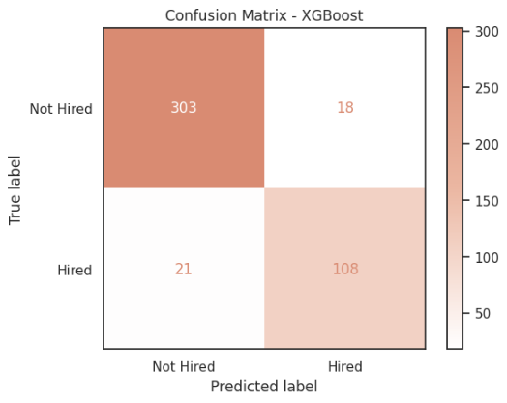
Confusion Matrix
The model correctly identified the majority of the data. Of the 450 data points, the model only incorrectly predicted 39.
The model successfully identified 108 of the 129 candidates who were actually Hired. There were 21 potential candidates missed (predicted as Not Hired), indicating room for improvement to capture more talent.
Based on the Confusion Matrix, the XGBoost model demonstrated solid performance in the recruitment process with a high level of accuracy and minimal misclassification.

Slide 29
Model Evaluation &
Business impact

Slide 30
Model Comparison
XGBoost outperformed Logistic Regression across all metrics.
F1 Score (77.5% → 84.7%). This quite sharp increase proves that the model is now more balanced and consistent in maintaining the quality of predictions between Precision and Recall.
While both models had high ROC-AUC scores, XGBoost was slightly better (88.9% → 91.3%).
Logistic Regression
F1 Score
ROC AUC
77.5%
88.9%
XGBoost
F1 Score
ROC AUC
84.7%
91.3%

Slide 31
Fairness and Bias Analysis
Feature | Subset | count | positives | positive_rate
RecruitmentStrategy | External | 237 | 27 | 0.114
RecruitmentStrategy | Internal | 133 | 92 | 0.692
RecruitmentStrategy | Referral | 80 | 10 | 0.125
EducationLevel | Diploma/Bachelor | 225 | 46 | 0.204
EducationLevel | High School | 98 | 25 | 0.255
EducationLevel | Magister | 92 | 38 | 0.413
EducationLevel | PhD | 35 | 20 | 0.571
ExperienceLevel | Junior | 48 | 8 | 0.167
ExperienceLevel | Medior | 118 | 30 | 0.254
ExperienceLevel | Senior | 284 | 91 | 0.32
Feature | Subset | count | positives | positive_rate
InterviewScore | Low | 154 | 41 | 0.266
InterviewScore | Medium | 153 | 28 | 0.183
InterviewScore | High | 143 | 60 | 0.42
SkillScore | Low | 140 | 25 | 0.179
SkillScore | Medium | 151 | 43 | 0.285
SkillScore | High | 159 | 61 | 0.384
PersonalityScore | Low | 161 | 39 | 0.242
PersonalityScore | Medium | 139 | 30 | 0.216
PersonalityScore | High | 150 | 60 | 0.4
Recruitment Strategy: The model recommends Internal Strategy significantly higher (0.69) than External or Referral Strategy (0.11), indicating a strong preference for internal sources.
Educational Level: The model tends to recommend candidates with higher education, particularly Master's (0.41) and PhD (0.57) graduates, compared to candidates with a high school or bachelor's degree (0.20 - 0.35)
Experience Level: The model prioritizes senior candidates, but the difference in positive rates across experience levels (Junior, Intermediate, Senior) does not show the extreme gaps found in education or recruitment strategy categories.
The model shows a pattern where higher scores increase a candidate's chances of being recommended for recruitment, particularly in the High score category.
The most significant gap is seen in the Interview Score, followed by the Personality Score. Meanwhile, Skill Score shows a more stable pattern across the Medium and High score ranges.

Slide 32
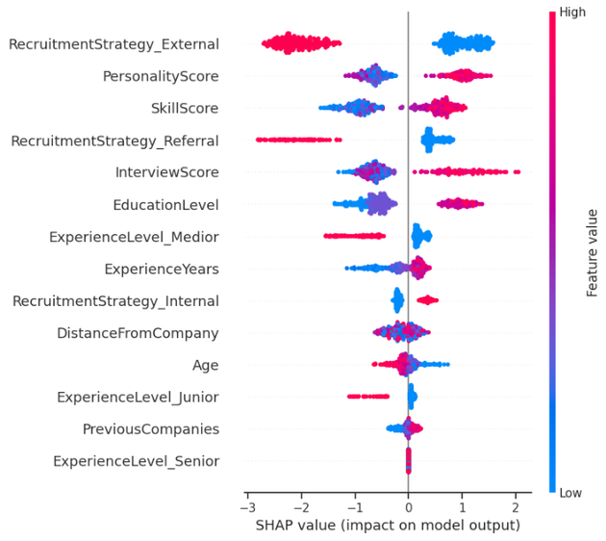
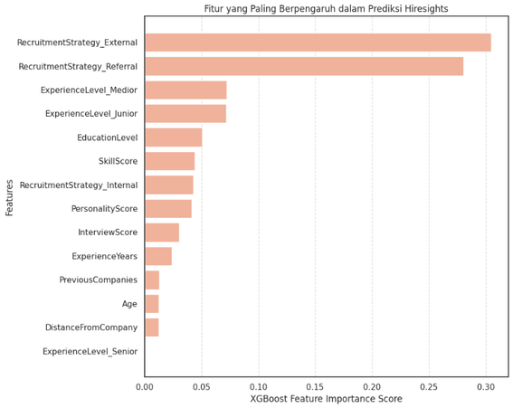
Feature Importance
RecruitmentStrategy_External is the most influential factor, with high feature scores (red) having a very strong negative impact on recruitment decisions.
EducationLevel had a significant positive impact; the higher a candidate's education level and total score, the greater their likelihood of being recommended.
PersonalityScore, InterviewScore, and SkillScore consistently showed a positive impact on the model. Candidates with high evaluation scores on these aspects were more likely to be hired.
The remaining factors, such as DistanceFromCompany, Age, and ExperienceLevel_Senior, had minimal or almost neutral impacts on the prediction model output.
Conclusion: The model was heavily influenced by the recruitment channel (External) and the candidate's academic quality/evaluation score, while demographic factors and specific experience (Senior) were not significant determinants in this model.
The graph shows that RecruitmentStrategy_Referral, RecruitmentStrategy_External, and ExperienceLevel_Medior are the most influential features in this recruitment prediction model.

Slide 33
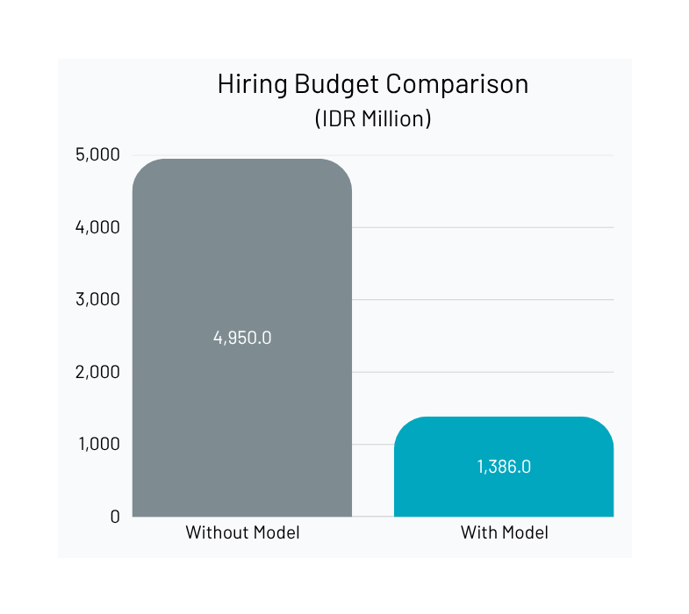
Business Impact
Based on confusion matrix, we have potential hire candidates as:
TP (108) + FP (18) = 126 out of 450 candidates
Cost per Hire: 11.000.000
With Model | Total Hire | Cost per Hire | Total Cost
Yes | 126 | 11.000.000 | 1.386.000.000
No | 450 | 11.000.000 | 4.950.000.000
Cost Saving: Rp 3,564 M
Cost Efficiency: 72 %

Slide 34
Recommendation
Data imbalance & bias: The dataset is limited and shows some bias. This is mitigated using the SMOTE algorithm, which balances data distribution and improves model representativeness.
Conduct a survey per quarter alongside HR Team to bolster data with more information, features to improve model accuracy and maintain model integrity
Retrain algorithm with new data and develop better model that is less biased and more fair.
Optimization of HR Workflow: HR team without the model will continue and screen manually candidates that might be a dud, this will cost the company money while having no benefits.
Dashboard utilization: using the dashboard, HR team can pre-screen the potential candidates without consuming a significant amount of hiring budget to screen off uncertain hires and save the hiring team effort and time.

Slide 35
Dashboard Implementation

Slide 36






Project Workflow
Predictive Machine Learning
A tuned XGBoost model processes the input to determine the approval probability.
Data Collection
Results Visualization
Candidate data is entered manually through an interactive form in the Streamlit sidebar.
The final results are displayed in real-time: "Hired/Not Hired" status.
Step 2
Step 1
Step 3

Slide 37
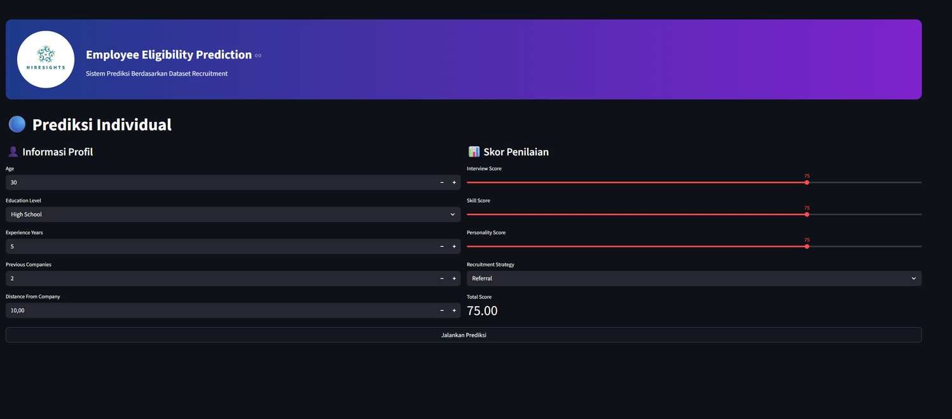

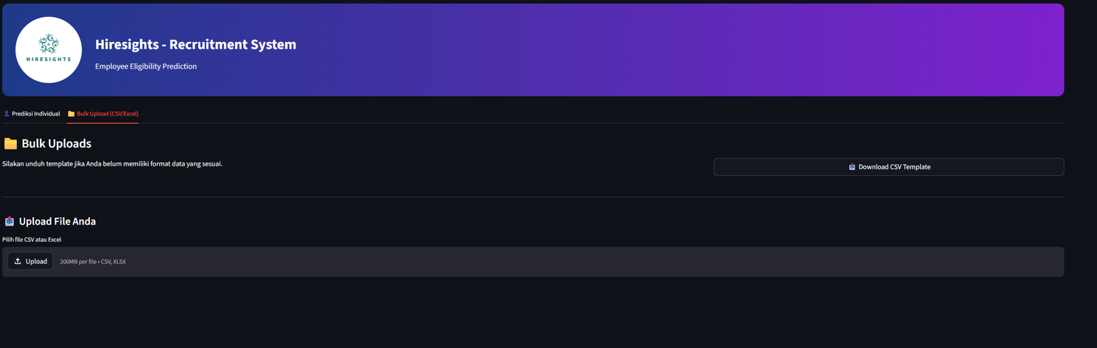
Mainpage Overview
GITHUB
[click here]
Users can dynamically modify candidate parameters.
Input changes instantly update the prediction results.

Slide 38
THANK YOU!

